Slide 1
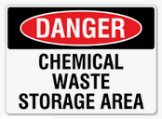
Floor Plan of Laboratory Layout
Building: Room(s): _
Fume
Hood
Bio Safety Cabinet
Control Area
CHP Binder
Local Exhaust
HF Acid Spill Kit
Corrosive Storage
Carcinogen Storage
Highly Toxic Storage
Reproductive Toxin Storage
Oxidizer Storage
Reactive Storage
Chemical Storage Refrigerator
Safety Glasses Station
Lab Coat Station

